Slide 1
Dockerizing of a Django web application
BY: LAKSHYA RAGHUWANSHI

Slide 2
AGENDA
Introduction to Docker
Why Django
Working with PostgreSQL
Personal Project

Slide 3
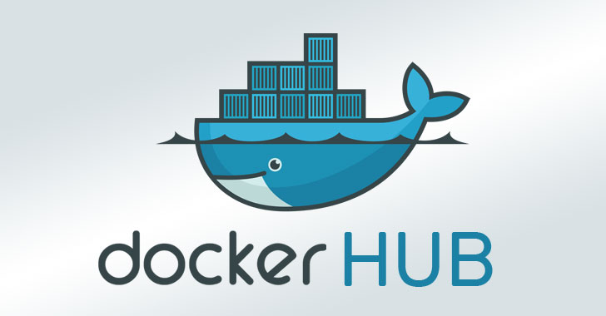
Introduction to Docker
Introduction to Docker
Introduction to docker
Docker is an open-source containerization platform used for developing, deploying, and managing applications in lightweight virtualized environments called containers.
It is mainly used as a software development platform for developing distributed applications that work efficiently in different environments. By making the software system agnostic, developers don’t have to worry about compatibility issues. Packaging apps into isolated environments (containers) also makes it easier to develop, deploy, maintain, and use applications.

Slide 4
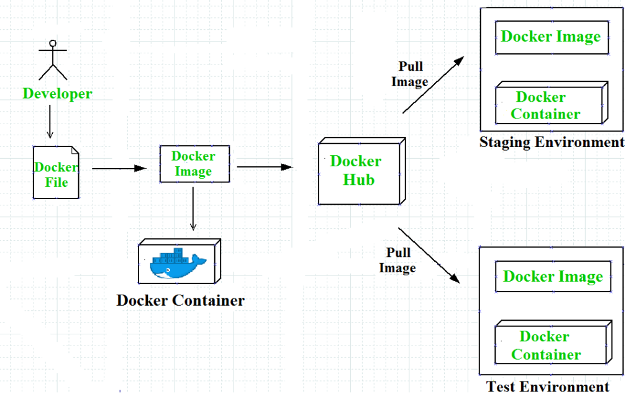

Slide 5
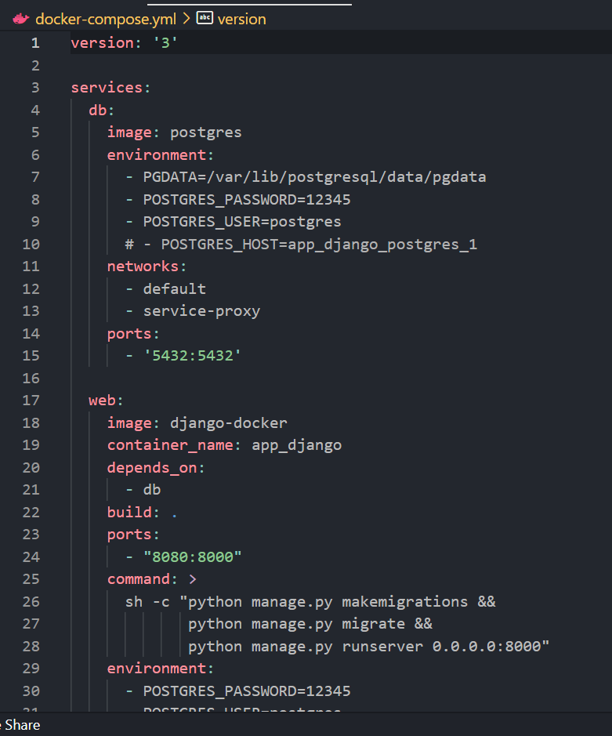
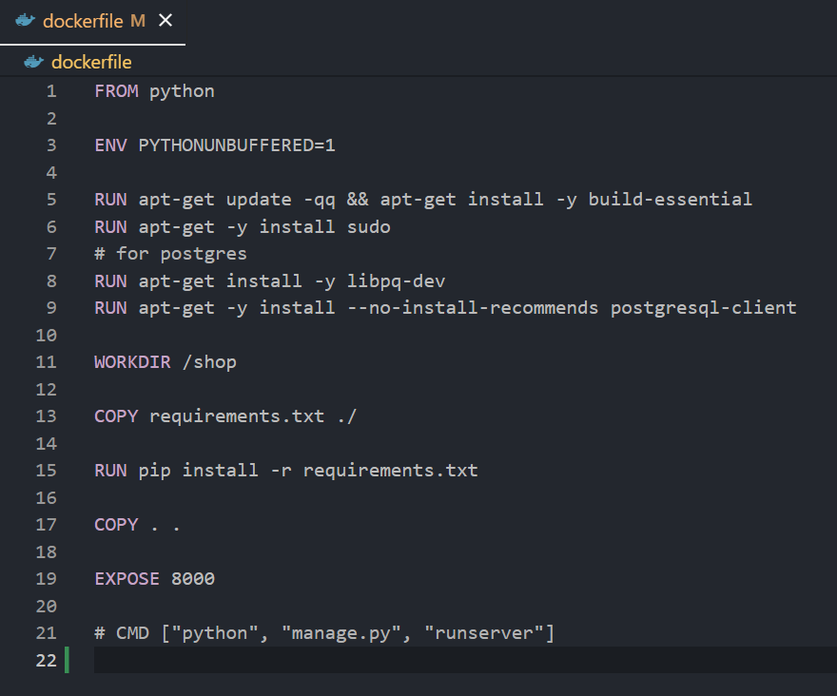
DockerFIle and Docker-compose

Slide 6
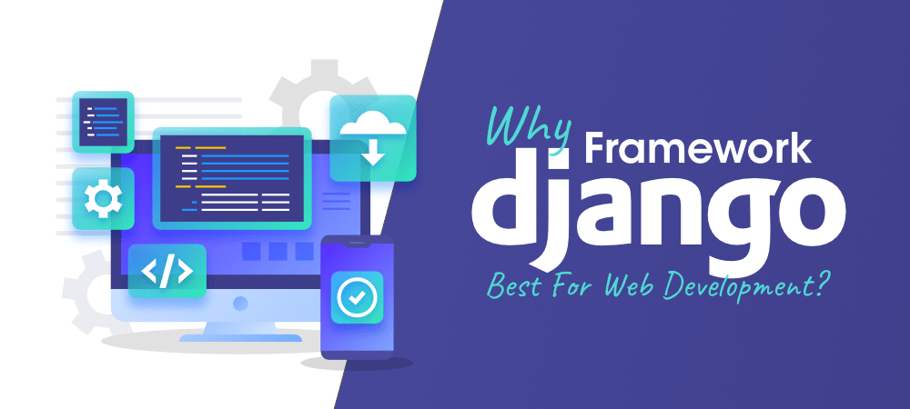
Why Django
Django is an open-source framework for backend web applications based on Python — one of the top web development languages. Its main goals are simplicity, flexibility, reliability, and scalability. And when introduced to what is Django, Python and its features open up in a new way.

Slide 7
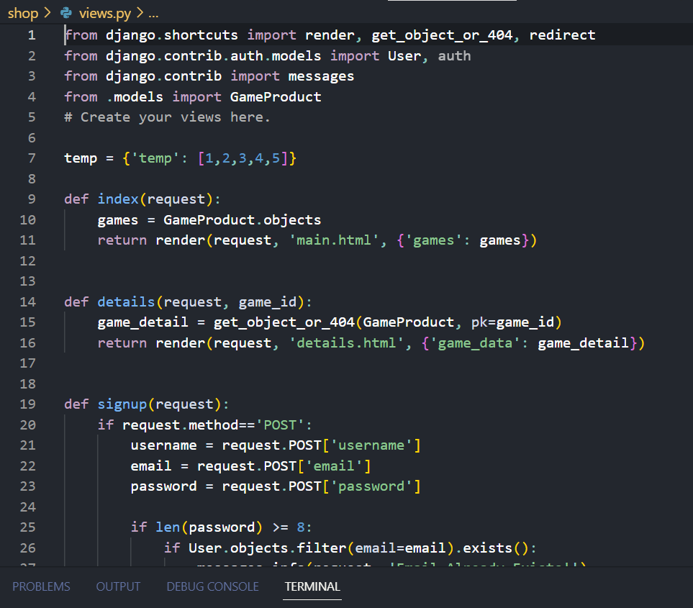
Django Features
Django has its own naming system for all functions and components (e.g., HTTP responses are called “views”). It also has an admin panel, which is deemed easier to work with than in Lavarel or Yii, and other technical Django features, including:
Simple syntax;
Its own web server;
MVC (Model-View-Controller) core architecture;

Slide 8
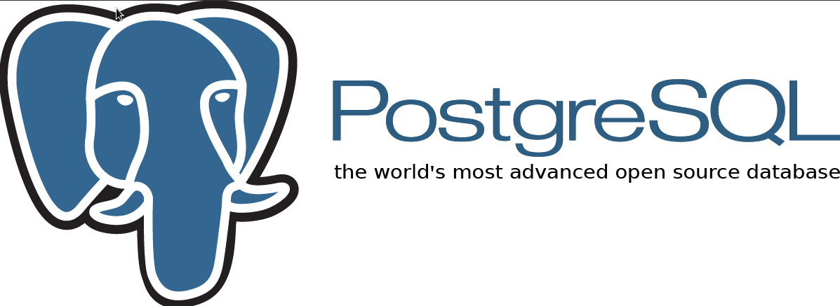
Working with postgresql
PostgreSQL is a free and open-source database management system. It’s commonly referred to as an alternative to MySQL or MariaDB.
The advantages of having an open-source database are:
Easier to find and fix issues, as you can access the code instead of waiting for the vendor to investigate it
Community-developed, meaning it can be developed and supported without a company.
Add your own features, if there’s something you want to add that doesn’t exist.

Slide 9
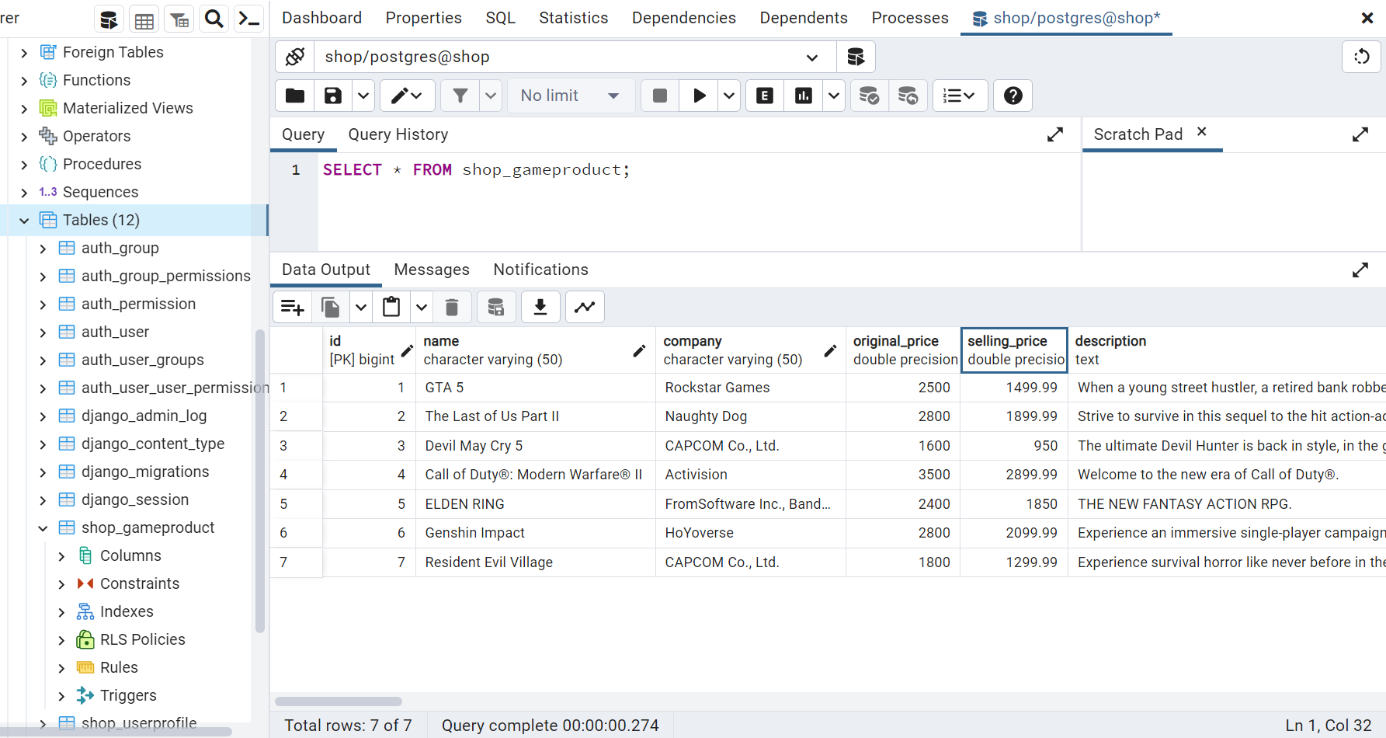
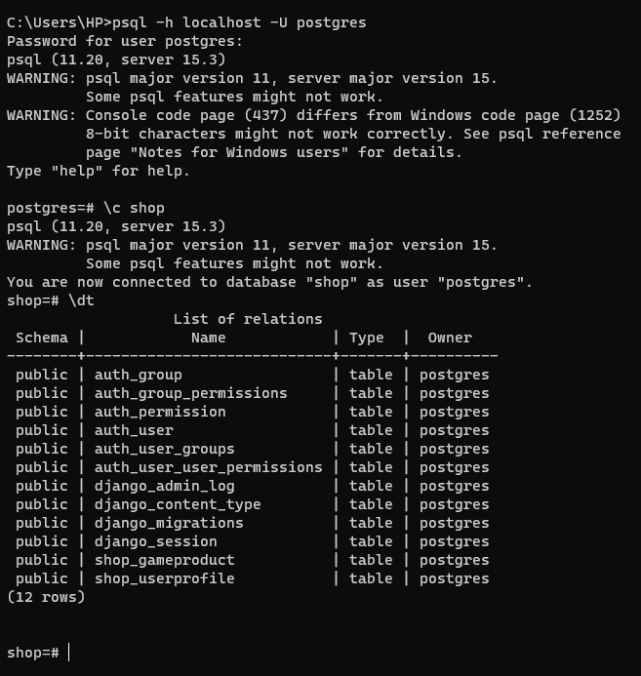

Slide 10
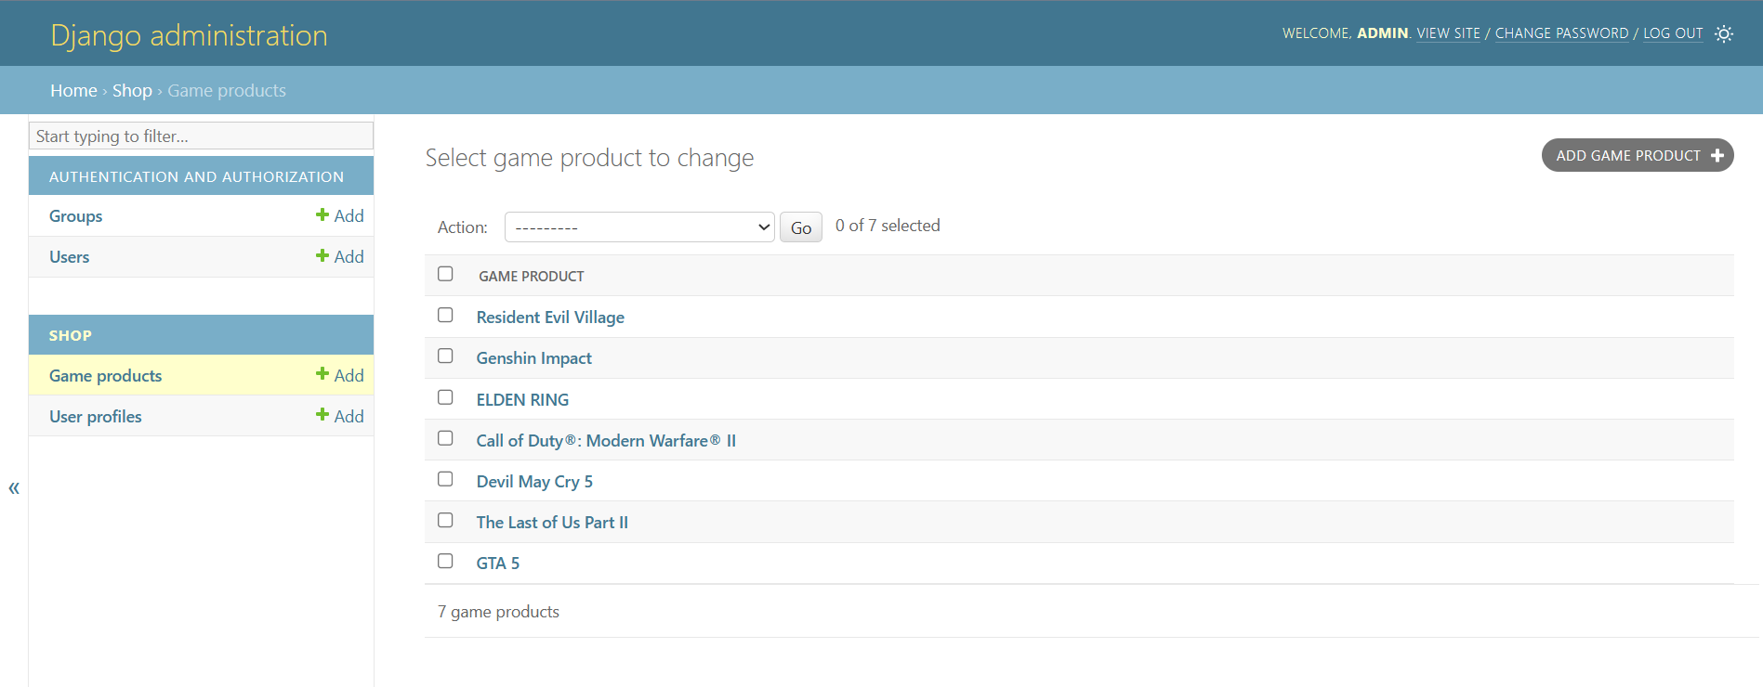
Django Administration
Django provides a dynamic CRUD (create, read, update and delete) interface, configured with admin models and generated via introspection. CRUD is used to describe the basic database commands, which means the interface facilitates viewing, changing, and searching for information.

Slide 11
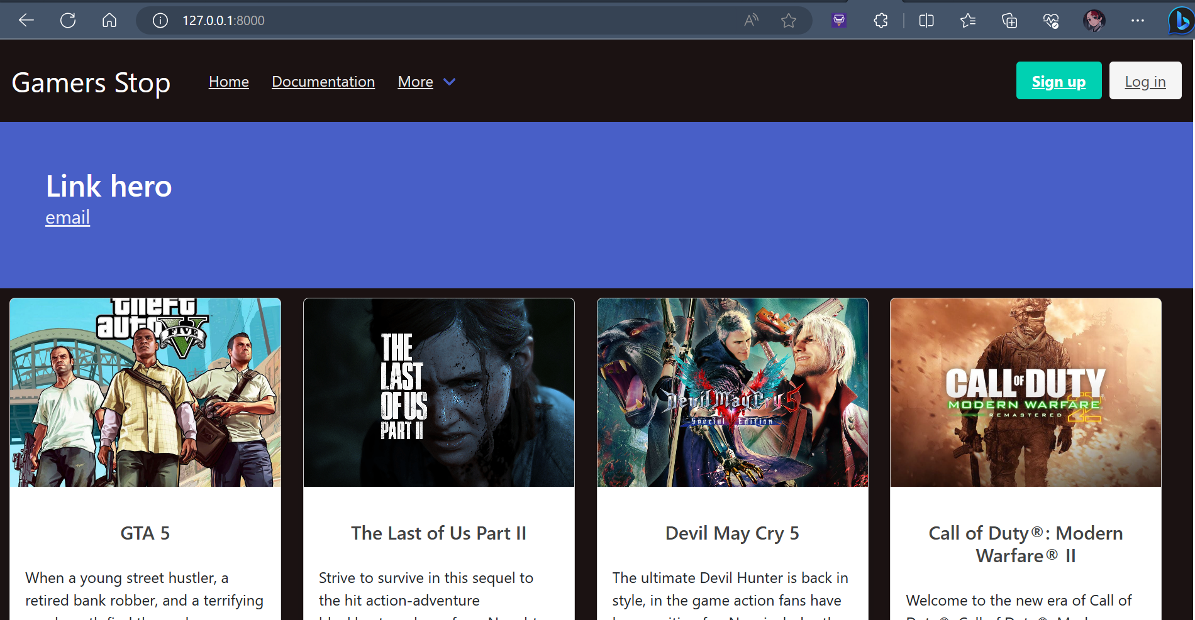
Gamers stop
Personal Project – An E-commerce Webite
Functionality:
Routing between different pages
Product models and working with them
Signup and Authentication Feature
Data Adding and retrieval

Slide 12
THANK YOU
Sources:
www.docker.com
www.geeksforgeeks.com
www.djangostars.com
www.databasestar.com

